Slide 1


Health Connect - Doctor's Appointment Booking System using AI
This presentation provides an overview of Health Connect, an AI-powered doctor's appointment booking system. Explore its features, benefits, challenges, and future potential.
By Mudasir, K S Aadthiyan, Kabilan

Slide 2

Importance of Doctor's Appointment Booking System
Efficient & Streamlined Process
Health Connect revolutionizes healthcare access by automating appointment booking, reducing administrative burden, and improving patient experience.
Enhanced Patient Care
Avoid long waiting times and fragmented care. Health Connect ensures patients receive timely, appropriate, and personalized medical attention.
Optimized Doctor's Schedule
With Health Connect, doctors can efficiently manage their calendars, reducing overbooking and ensuring better time management.

Slide 3

Key Features of Health Connect
AI-Powered System
Using advanced machine learning algorithms, Health Connect intelligently matches patients with suitable doctors, providing personalized recommendations.
Efficient Appointment Booking Process
Health Connect streamlines the booking process, allowing patients to easily find available slots, choose preferred doctors, and receive instant confirmations.
Seamless Patient and Doctor Experience
Health Connect offers a user-friendly interface for patients to manage their appointments, while doctors have access to all relevant patient information.

Slide 4

Benefits of Health Connect
Improved Patient Access to Healthcare Services
Health Connect ensures equal access to quality healthcare by eliminating barriers like geographical distance and limited availability of specialists.
Reduction in Waiting Times for Appointments
By optimizing doctor's schedules and eliminating manual administrative tasks, Health Connect significantly reduces waiting times for patients.
Enhanced Doctor's Schedule Management
Health Connect empowers doctors with efficient schedule management tools, enabling them to serve more patients without compromising quality of care.

Slide 5
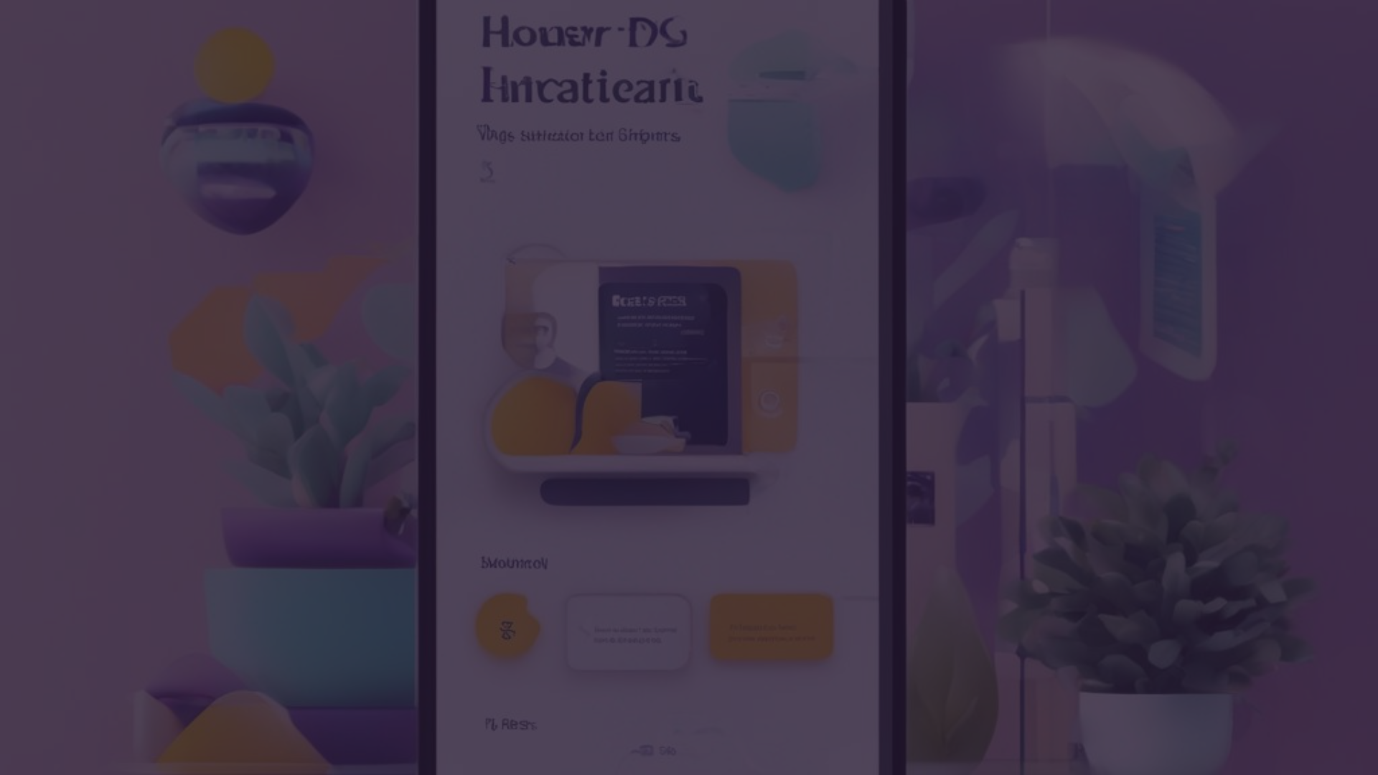
Challenges and Solutions
Technical Challenges in AI Implementation
Overcoming algorithm training, real-time data processing, and system integration challenges ensures the seamless functioning of Health Connect.
Ensuring Data Privacy and Security
Health Connect prioritizes patient data privacy and employs robust security measures to protect against unauthorized access and data breaches.
Training Healthcare Providers and Patients to Use the System
Successful adoption of Health Connect requires comprehensive training programs for healthcare providers and patients to maximize its benefits.

Slide 6

Future of Health Connect
Potential for Expansion and Integration
Health Connect's scalable infrastructure allows for seamless integration with other healthcare systems, enabling comprehensive patient management.
Advancements in AI Technology
With ongoing advancements in AI, Health Connect will continuously evolve to offer more accurate recommendations and personalized healthcare services.

Slide 7

Conclusion
Recap of Key Points
Health Connect is an AI-powered doctor's appointment booking system that streamlines healthcare access, benefits patients and doctors, and addresses critical challenges.
Call to Action
Adopt Health Connect to revolutionize your healthcare experience and join the future of seamless and personalized medical care.

